Slide 1
Module 1 AA: The importance of early diagnosis and referrals to specialized centers of care

Slide 2
Author disclosures
Advisory board: Pfizer, Novartis, Alexion Astrazenica, Omeros, Sobi
Lecture fees/travel support: Pfizer, Alexion, AstraZeneca, Sobi, Novartis, Amgen

Slide 3
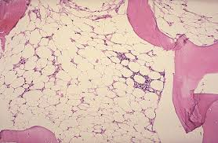
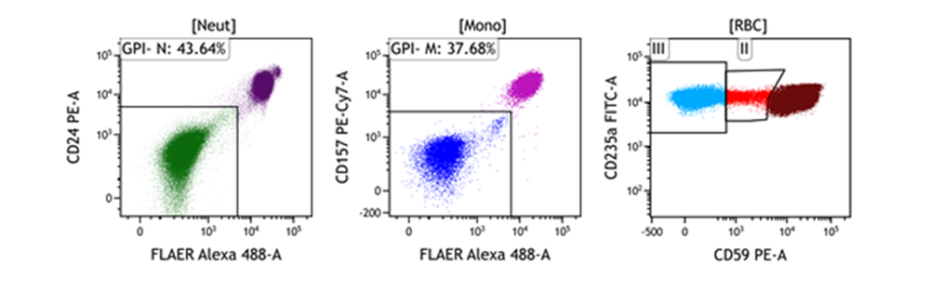
Aplastic anemia facts
Overall incidence of 2.35 (95% CI: 2.06–2.64) cases per million inhabitants per year
AA is more common in the Far east
Biphasic peak 15–25 and over 60 years of age
Categorised as per camitta criteria
Inherited causes – more common in children
Most common clonal change in AA is the presence and progression of a PNH clone (40–60% patients)
Notes:
Abbreviation(s):
AA, aplastic anemia; CI, confidence interval; PNH, paroxysmal nocturnal hemoglobinuria.
Reference(s):
Vaht K, et al. Haematologica 2017;102(10):1683–1690.
Issaragrisil S, et al. Blood 2006;107(4):1299–1307.
Muir KR, et al. Br J Haematol 2003;123:906–914.
Camitta BM, et al. Blood 1975;45(3):355–363.
Kulasekararaj A, et al. Br J Haematol 2024;204(3):784–804.

Slide 4
Patient approach and Common symptoms
History
Importance of preceding vaccinations
Occupational history
New medications
Concurrent disease – including AI diseases
Secondary Aplastic anemia requires treatment of the underlying disease
Family history of early death, haematology disorders or malignancy
May indicate inherited disorder
Good clinical examination
Dysmorphia - short stature; hypoplastic thumbs, early grey hair
Potential for inherited disorders
Symptoms
Bleeding and petichae – due to low platelets
Low energy – due to anemia – may be a gradual progression younger patients tolerate low Hb
Recurrent infections – due to neutropoenia
Jaundice – if associated with hepatitis
Notes:
Abbreviation(s):
AI, autoimmune.

Slide 5
Inherited bone marrow failure
 | Inheritance pattern | Bone marrow failure | Short telomeres? | Phenotypic features
Fanconi anemia | AR, XLR, AD | >90% | Yes | Café au lait spots Short stature Thumb abnormalities
Dyskeratosis Congenita | XLR, AR | 80% | Yes | Skin pigmentation Oral leukoplasia Nail dystrophy Premature grey hair Lung and liver fibrosis
Shwachman-Diamond | AR | 20% | Yes | Pancreatic insufficiency Short stature Thoracic abnormalities
Diamond Blackfan anemia | AD, AR | Red cells aplasia, BM rare | Yes | Cleft palate Microcephaly Low hair line Absent thumbs
Notes:
Abbreviation(s):
AD, autosomal dominant; AR, autosomal recessive; BM, bone marrow; XLR, X-linked recessive.
Reference(s):
Kulasekararaj A, et al. Br J Haematol 2024;204(3):784–804.

Slide 6
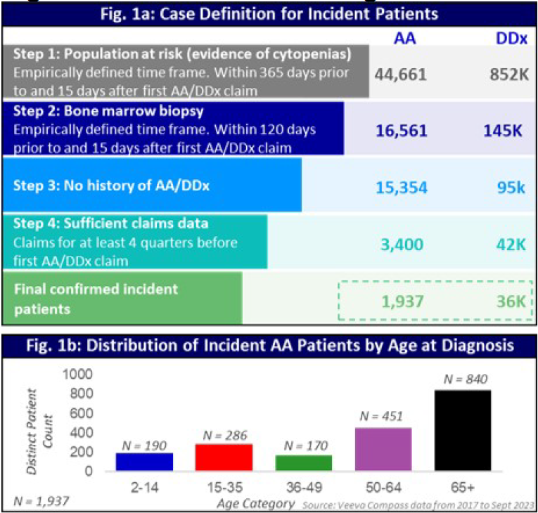
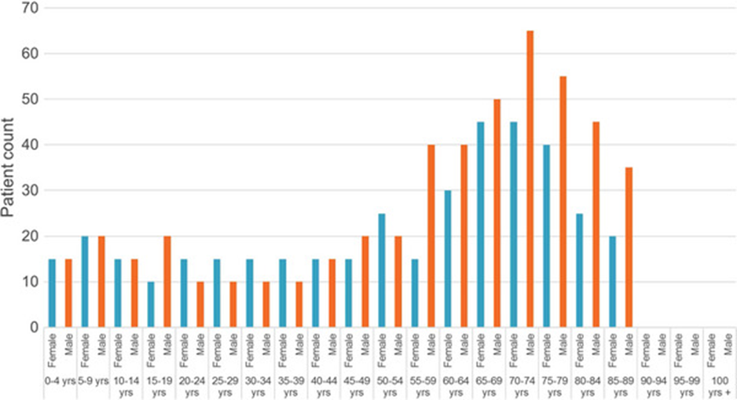
Analysis of Real-World Data to Identify Predictors for Earlier Diagnosis of Aplastic Anemia
Increased incidence of aplastic anemia in female patients and in those with older age (≥65 years)
UK HES data: First hospitalisation with patients with aplastic anaemia
Scheinberg P, et al. Analysis of Real-World Data to Identify Predictors for Earlier Diagnosis of Aplastic Anemia. Abstract presented at EHA 2024; Madrid, Spain; June 13–16, 2024. Abstract PB2674 (publication only) ; Famokunwa B, Gupta A, Thomas S, Griffin M, Kulasekararaj A. Mapping aplastic anaemia hospital activity in England. EJHaem. 2024 Mar 22;5(2):414–417;
Notes:
Abbreviation(s):
AA, aplastic anemia; DDx, differential diagnosis; HES, hospital episode statistics
Reference(s):
Scheinberg P, et al. Presented at EHA 2024; Madrid, Spain; June 13–16, 2024. Abstract PB2647 (publication only).
Famokunwa B, et al. EJHaem 2024;5(2):414–417.
Data Source: All-payor US medical and prescription claims data (Veeva Compass) of 330M people fromJanuary 2017 to September 2023. Population At Risk (PAR) and Incident Cases: The PAR for undiagnosed AAand its differential diagnosis (DDx) included patients with peripheral cytopenia of ³** 2 blood cell types whohad ³1 AA and/or DDx related claim(s) from any clinical setting. To be classified as likely incident cases,patients required a bone marrow biopsy before the first AA or DDx claim. Patients were further categorized ascases of AA or DDx based on the diagnosis with most claims. Modeling: Predictors of undiagnosed AA wereidentified via logistic regression with DDx as a reference group. Then, T0-TDx was estimated using a movingaverage to calculate claims volumes over time, defining T0 as the start of accelerating claims volumes, anddefining TDx as the time of the first AA or DDx claim.Results:From the identified >850K patients at risk, there were an estimated 1,937 incident cases of all AAs (Fig. 1a) witha bimodal distribution that skews towards the elderly (Fig. 1b) and females (55%).The median T0-TDx for AA was 95 days. AA patients had significantly more claims than healthy controls for ³3years before TDx and claims volume increased sharply at one-year pre-diagnosis.Patients exhibited notable heterogeneity in claims volume. Four distinct clusters were identified with abetween-cluster difference in T0-TDx (Kruskal–Wallis, p<0.001). Clusters 1 and 3 had less intense management,the shortest T0-TDx, and the longest time to treatment (TRx), suggesting less severe AA. By contrast, clusters 2and 0 had a longer T0-TDx, with more intense management and hepatic failure (OR=11.8, p<0.001),respectively. The latter had the longest T0-TDx. Cluster 2 had the 2nd longest T0-TDx but the shortest TDx-TRx.The probability of undiagnosed AA was lower in patients with symptomatic monocytosis and relapsingleukemia, and higher in those with nutritional marasmus, congenital anemias, diffuse eosinophilic fasciitis, PNHand reactive hepatitis. AA was diagnosed earlier in patients with R-sided heart failure, hepatitis, fluid overload,acute kidney failure and severe AA, and later in patients with transfusion-associated fluid overload, alkalosis,encephalitis and cutaneous vasculitis.Summary/Conclusion:This is the largest epidemiological analysis of incident AA across all real-world clinical settings, making it morerepresentative of the true epidemiology of AA. An older cohort of patients was identified than in classicalliterature1, reflecting a potential referral bias against the elderly for care at tertiary or trial centres. Furtherresearch is needed to confirm this finding.This study also identifies variables that may increase the index of suspicion for AA, potentially enabling earlier
First hospitalisation for patients with aplastic anaemia by 5‐year age bands and gender (2017/2018–2021/2022) †. †This study uses data provided by patients and collected by the NHS as part of their care and support. Secondary care data is taken from the English Hospital Episode Statistics (HES) database produced by NHS England

Slide 7
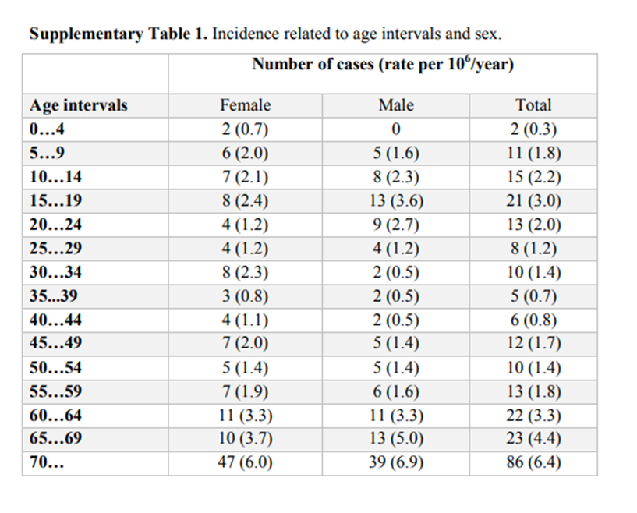
Age at diagnosis
Swiss data
Clinical trial data usually presents with a younger age cohort
USA: Most patients are ≥50 years, with a higher incidence in those aged ≥65 years,
UK data: HES data: increased diagnosis in the >60’s
Potential care gap in older patients with aplastic anemia, necessitating earlier referral and diagnosis, followed by appropriate treatment
Vaht K et al. Haematologica. 2017 Oct;102(10):1683–1690.
Notes:
Abbreviation(s):
HES, hospital episode statistics.
Reference(s):
Vaht K, et al. Haematologica 2017;102(10):1683–1690.

Slide 8
Patient 1: 30-year-old professional rugby player
Noticed reduction in training abilities
Moderate alcohol intake; vegan
Attended GP: FBC – Hb 60g/l, WCC 1x10*9/l, neutrophils 0.2x10*9/l, plt 20x10*9/l, MCV 105 (NR 80-100)
Next tests?
Differential diagnosis?
Notes:
Abbreviation(s):
FBC, full blood count; GP, general practitioner; Hb, hemoglobin; MCV, mean corpuscular volume; plt, platelet; WCC, white blood cell count.
Reference(s):

Slide 9
Assessment question 1
Notes for author: please create an assessment question with at least 3 multiple choice options.
This can either test the user on a point about to be covered or, for example, asking how they might manage one of your case examples (prior to explaining how you did)
There is an example question in the briefing document
Question: Please rank the tests in order you would do them
Answers: | Positive feedback (fill in for correct answer) | Negative feedback (fill in for incorrect answers
Option 1 | Additional bloods – reticulocyte count; Renal and liver function, LDH, blood film; hematinics, parvovirus
Option 2 | PNH screen
Option 3 | Bone marrow
Solution: Aplastic anemia is a rare disease - dietary deficiencies, alcohol, MDS/leukemia are more common. Its important to approach a case logically and step wise.
References:
Notes:
Abbreviation(s):
LDH, lactate dehydrogenase
Reference(s):

Slide 10
Results of your investigations
Reticulocytes 20x10*9/l
B12 200ng/l (NR 220-900); Folate 4ug/l (NR 5-24); ferritin 20 ug/l (NR 10-320)
Renal and liver function normal
Blood film – no blasts; in keeping with peripheral automated counts
PNH screen negative
Notes:
Abbreviation(s):
NR, normal range.
Reference(s):

Slide 11
Assessment question 2
Notes for author: please create an assessment question with at least 3 multiple choice options.
This can either test the user on a point about to be covered or, for example, asking how they might manage one of your case examples (prior to explaining how you did)
There is an example question in the briefing document
Question: Possible diagnosis to discuss with the patient
Answers: | Positive feedback (fill in for correct answer) | Negative feedback (fill in for incorrect answers
Option 1 | Acute leukemia
Option 2 | Myelofibrosis
Option 3 | Aplastic anemia
Solution: All three diagnosis remain possible, until the bone marrow is available
References:
Notes:
Abbreviation(s):
Reference(s):

Slide 12
Investigations required as per BCSH guidelines
Bloods:
FBC, reticulocyte count, blood film, haematinics, LFT’s – reticulocytes 20x10*9/l; hematinics normal
Virology: Hepatitis A/B/C, HIV, EBV, CMV and parvovirus – negative
AI screen: ANA and DS DNA - negative
PNH screen - negative
Chromosome breakage: Fanconi anemia <50 years - negative
Inherited bone marrow failure screen – negative
HLA DR - normal
Radiology:
CXR baseline; hands, forearms and feet if inherited BMF anticipated – CXR normal
HRCT if concerns about Dyskeratosis - NA
AUSS: splenomegaly - ? Alternative diagnosis; abnormal kidneys – Fanconi anemia - normal
Bone marrow:
Aspirate, trephine, cytogenetics
FISH: chromosomes 5, 7, 8 and 13 - Normal
Myeloid panel – Normal
Young patients
Telomeres - Normal
Whole genome sequencing
Kulasekararaj A, et al. Br J Haematol. 2024.
Notes:
Abbreviation(s):
AI, autoimmune; ANA, antinuclear antibodies; AUSS, abdominal ultrasound scan; BMF, bone marrow failure; CXR, chest X-ray; DS, double-stranded; EBV, Epstein-Barr virus; FBC, full blood count; FISH, fluorescence in situ hybridization; HLA, human leukocyte antigen; HRCT, high-resolution computed tomography; LFT, liver function test; NA, not applicable; PNH, paroxysmal nocturnal hemoglobinuria.
Reference(s):
Can have AI AA associated with SLE
HLA DR2 suggests increased response to IST
12 % patients with AA will have trisomy 8, del 13q
Somatic mutations are present in 20%–30% of cases of idiopathic AA,

Slide 13
Investigations required as per BCSH guidelines
Bloods:
FBC, reticulocyte count, blood film, haematinics, LFT’s
Virology: Hepatitis A/B/C, HIV, EBV, CMV and parvovirus
AI screen: ANA and DS DNA
PNH screen
Chromosome breakage: Fanconi anemia <50 years
Inherited bone marrow failure screen
HLA DR
Radiology:
CXR baseline; hands, forearms and feet if inherited BMF anticipated
HRCT if concerns about Dyskeratosis
AUSS: splenomegaly - ? Alternative diagnosis; abnormal kidneys – Fanconi anemia - normal
Bone marrow:
Aspirate, trephine, cytogenetics
FISH: chromosomes 5, 7, 8 and 13
Myeloid panel
Young patients
Telomeres
Whole genome sequencing
Kulasekararaj A, et al. Br J Haematol. 2024.
Notes:
Abbreviation(s):
AI, autoimmune; ANA, antinuclear antibodies; AUSS, abdominal ultrasound scan; BMF, bone marrow failure; CXR, chest X-ray; DS, double-stranded; EBV, Epstein-Barr virus; FBC, full blood count; FISH, fluorescence in situ hybridization; HLA, human leukocyte antigen; HRCT, high-resolution computed tomography; LFT, liver function test; NA, not applicable; PNH, paroxysmal nocturnal hemoglobinuria.
Reference(s):
Can have AI AA associated with SLE
HLA DR2 suggests increased response to IST
12 % patients with AA will have trisomy 8, del 13q
Somatic mutations are present in 20%–30% of cases of idiopathic AA,

Slide 14
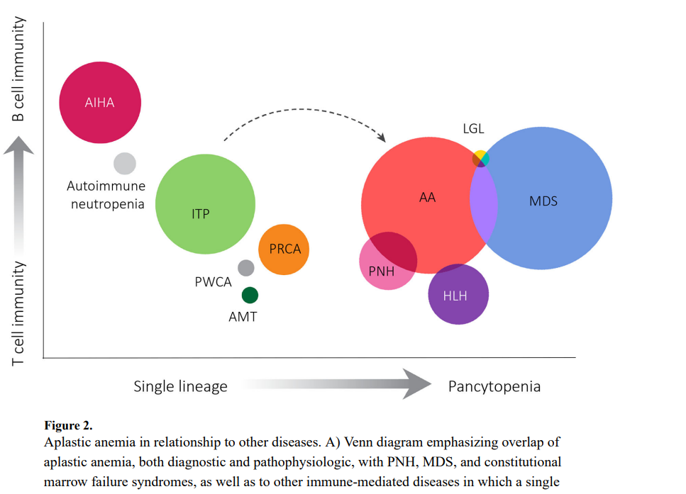
Aplastic anemia differential diagnosis
Can be difficult due to overlapping with other entities
All results and patient case should be discussed with an experienced centre
AA, aplastic anemia; AML, acute myeloid leukaemia; DKC, dyskeratosis congenital; LGL, large granular lymphocytosis; MDS, myelodysplastic syndromes; PNH, paroxysmal nocturnal hemoglobinuria; SDS, Schwachman-Diamond syndrome. Young N. Aplastic anemia. N Engl J Med. 2018 October 25; 379(17): 1643–1656. doi:10.1056/NEJMra1413485.
Notes:
Abbreviation(s):
AA, aplastic anemia; AML, acute myeloid leukaemia; DKC, dyskeratosis congenital; LGL, large granular lymphocytosis; MDS, myelodysplastic syndromes; PNH, paroxysmal nocturnal hemoglobinuria; SDS, Schwachman-Diamond syndrome.
Reference(s):

Slide 15
Aplastic anemia pathogenic mechanisms
Pathogenic mechanisms | Causes | Treatments
Autoimmune mechanism¹ | Autoimmune dysfunction | Immunosuppressive therapy HSCT TPO-agonists
Direct injury of the hematopoietic stem cell^{2,3} | Chemicals, irradiation, drugs | Hematopoietic growth factors Remove the chemical/drug HSCT
Constitutional genetic defects^{4,5} | Fanconi anemia, telomeropathies, germline gene mutations | HSCT Androgens Corticosteroids TPO-agonists
. Kulasekararaj A, et al. Br J Haematol. 2024;204(3):784–804; Uss AL, et al. Stem Cells. 1997;15(Suppl. 2):299–303; Cheng Y, et al. Front Endocrinol (Lausanne). 2023;14:1064723;. Calado RT and Clé DV. Hematology Am Soc Hematol Educ Program. 2017;(1):96–101; Liu Y and Karlsson S. Leukemia. 2024;38(1):1–9. Erratum in: Leukemia. 2024;38(1):228.
Notes:
Abbreviation(s):
HSCT, hematopoetic stem cell transplant; TPO, thrombopoietin receptor.
Reference(s):

Slide 16

MDT and diagnostic driven approach
Aplastic anemia is a rare disease
Patients should be treated in an experienced centre
Early diagnosis enables a treatment plan to be determined and reduce complications risks
MDT approach is recommended to collate results and develop a treatment plan
Histopathology review – good bone marrow samples required
Treatment plan determined by clinicians familiar with managing aplastic anemia
Expert advice on the diagnosis and management of patients where there is uncertainty, or when an inherited bone marrow failure syndrome is considered
Psychology support advised
Patient support group: https://www.theaat.org.uk/
Kulasekararaj A, et al. Br J Haematol. 2024;204(3):784–804
Notes:
Abbreviation(s):
MDT, multidisciplinary team.
Reference(s):

Slide 17

Aplastic anemia diagnostic criteria
Non-severe AA | Patients not fulfilling the criteria for severe or very severe aplastic anemia
Severe AA | BM cellularity <25%, or 25-50% with <30% residual hemopoietic cells 2/3 of the following: neutrophils <0.5 x 10⁹/l platelets < 20 x 10⁹/l reticulocytes <60 x 10⁹/l
Very severe AA | As for severe AA but neutrophils <0.2 x 10⁹/l
. Kulasekararaj A, et al. Br J Haematol. 2024;204(3):784–804;
Notes:
Abbreviation(s):
AA, aplastic anemia; BM, bone marrow.
Reference(s):

Slide 18
Supportive medications
Should be commenced whilst diagnosis is being determined
Prophylactic antiviral, antibiotic and antifungal drugs – if neutrophils <0.5x10*9/l
Transfusions
Should be irradiated for patients having ATG and HSCT
Management of iron overload
Vaccinations in AA
Avoid live vaccines
Inactive vaccinations may be given after thoroughly considering and balancing risk versus benefit
Post-transplantation AA patients should follow standard post-transplantation guidelines for vaccine administration
1. Kulasekararaj A, et al. Br J Haematol. 2024.
Notes:
Abbreviation(s):
ATG, anti-thymocyte globulin; HSCT, hematopoietic stem cell transplantation.
Reference(s):

Slide 19
How is the rugby player?
Diagnosis: Very severe aplastic anemia
Hb 60g/l, WCC 1x10*9/l, neutrophils 0.2x10*9/l, plt 20x10*9/l
Medications: Supportive commenced: Antifungal, antiviral and antibiotics
Blood products: irradiated blood and platelets
Psychological: Unable to compete; professional career break]
Counselling from work package
Holiday to South America cancelled
Family psychological support required
Benefits: PIP claim, critical illness cover activated
Treatment plan: No siblings
Notes:
Abbreviation(s):
HB, hemoglobin;, WCC, white blood cell count
Reference(s):

Slide 20
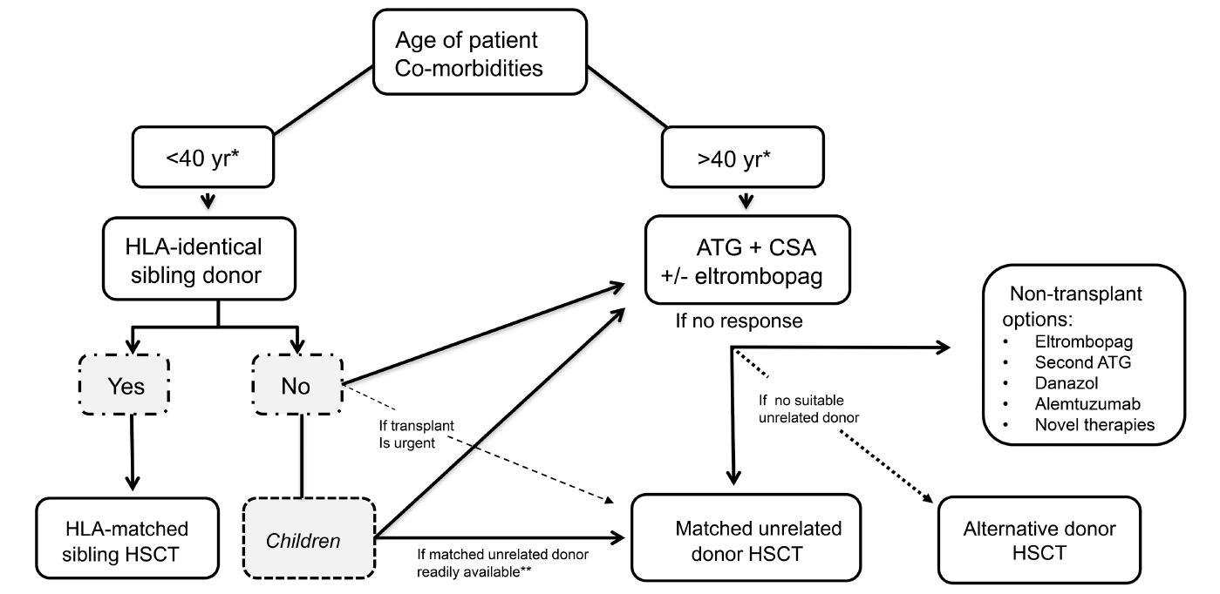
BSH treatment guidelines – acquired SAA
Kulasekararaj A, et al. Br J Haematol. 2024.
Notes:
Abbreviation(s):
ATG, anti-thymocyte globulin; CSA, cyclosporin; HLA, human leukocyte antigen; HSCT, hematopoetic stem cell transplant; SAA, severe aplastic anemia.
Reference(s):
Kulasekararaj A, Cavenagh J, Dokal I, Foukaneli T, Gandhi S, Garg M, Griffin M, Hillmen P, Ireland R, Killick S, Mansour S, Mufti G, Potter V, Snowden J, Stanworth S, Zuha R, Marsh J; BSH Committee. Guidelines for the diagnosis and management of adult aplastic anaemia: A British Society for Haematology Guideline. Br J Haematol. 2024 Jan 21. doi: 10.1111/bjh.19236.

Slide 21
Summary
Aplastic anemia is a rare disease
Whilst there is a biphasic peak, it is increasingly common in the elderly
Patients should be treated in an experienced centre
Early diagnosis of patients enables early treatment commencement
Signposting to patient support groups and psychological support is essential

